Slide 1

Balking design pattern
Group members:
Abubakar
Yasin

Slide 2

Introduction: it is a behavioral pattern in software design.
Intent: Prevent an object from performing an action unless specific preconditions.
Scenario: Often used in scenarios where actions need to be delayed or avoided based on the current system state.

Slide 3
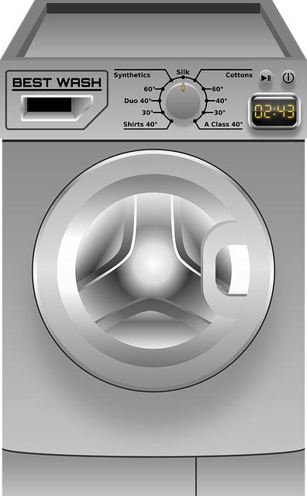

Washing-machine scenario
Washing-Machine Example
Scenario:
A Washing-Machine with two states: ENABLED and WASHING.
Transition between states using a thread-safe method.
Balking mechanism to avoid unnecessary washing if the machine is already in the process.

Slide 4
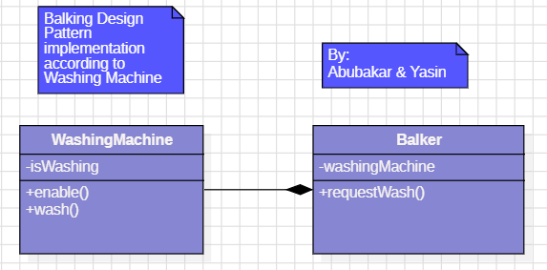
Balking Design Pattern - Structure diagram for washing-Machine

Slide 5

Pros of Balking Design Pattern
Efficient Resource Usage: Avoids unnecessary work or resource usage when preconditions are not met.
Simplicity: Clear separation of concerns between checking preconditions and executing actions.
Prevents Redundant Work: Avoids execution of redundant or ineffective actions, leading to more efficient processing.

Slide 6

of Balking Design Pattern
Potential for Missed Opportunities: May cause an object to miss opportunities if it becomes overly cautious about system state.
Complexity in Asynchronous Systems: Can be more complex in asynchronous systems; proper synchronization is needed.
Maintenance Challenges: Logic may become scattered and difficult to maintain if not implemented carefully.

Slide 7
When to Use Balking Design Pattern
Use Case Dependent:
Suited for scenarios where certain actions should be delayed or avoided based on the current system state.
Resource-Intensive Operations:
Useful for avoiding resource-intensive operations when conditions for success are not met.
Event-Driven Systems:
Applicable in event-driven systems to delay or skip actions based on specific events.

Slide 8

Conclusion:
Balking Design Pattern is a valuable tool for improving efficiency and avoiding unnecessary work in certain scenarios.
Careful consideration of use cases and potential drawbacks is essential for effective implementation.

Slide 9

Thank You!
yasinjamal2020@gmail.com

